Slide 1
SMS Spam Detection

Slide 2
Problem Statement
This data set is a set of SMS tagged messages that have been collected for SMS Spam research, tagged according being ham (legitimate) or spam.

Slide 3
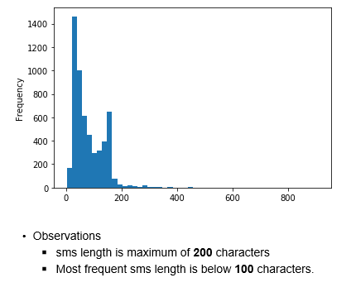
Analysis based on SMS length

Slide 4
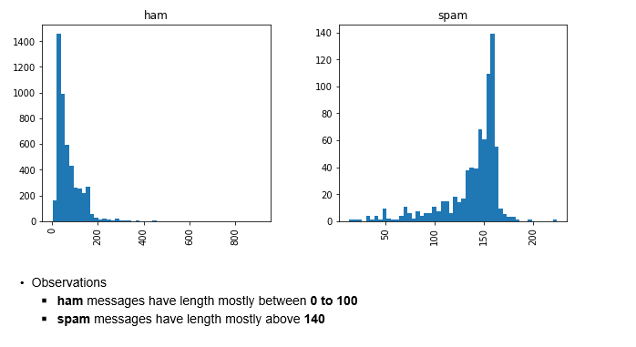
Analysis based on SMS length and label

Slide 5
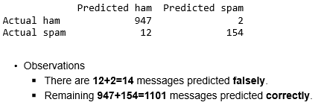
Model Creation and Evaluation
Model is created with Naive Bayes algorithm

